Slide 1
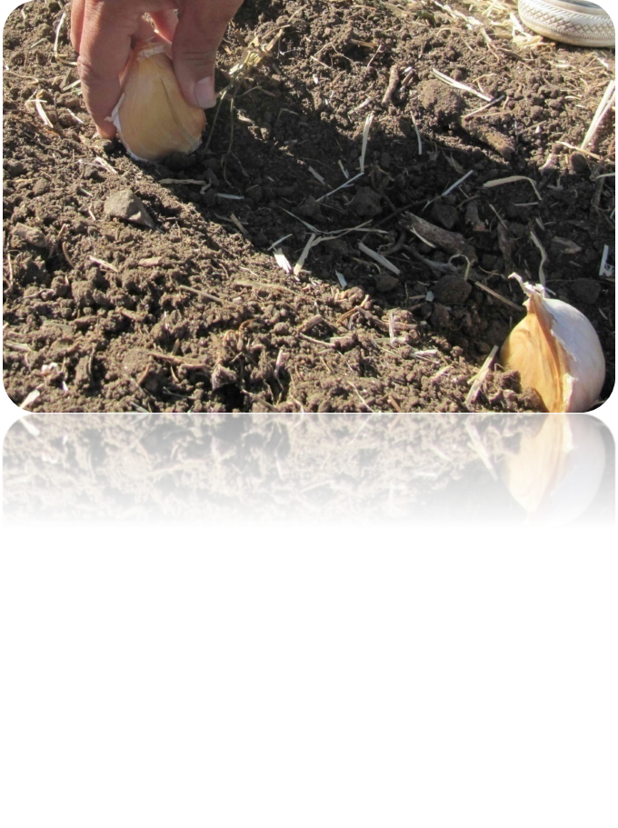
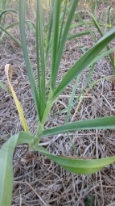
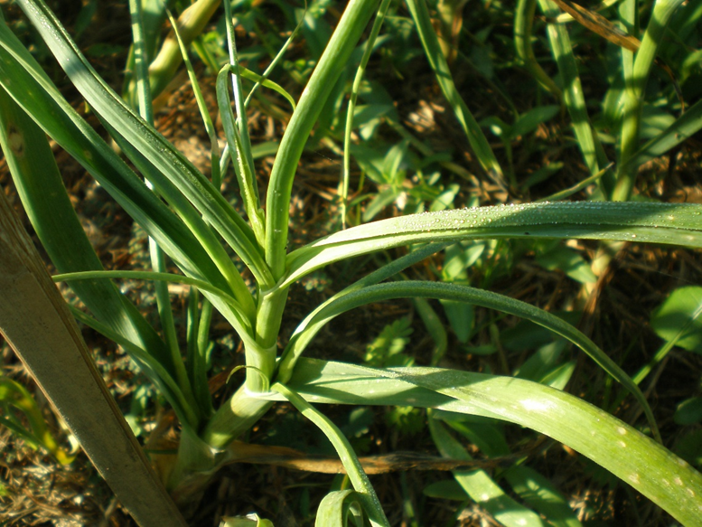
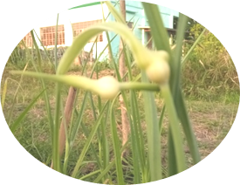
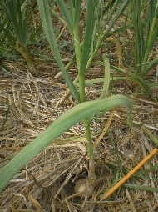
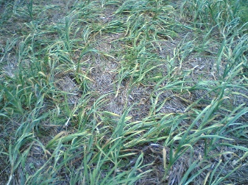
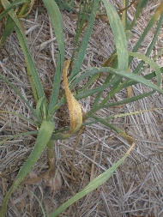
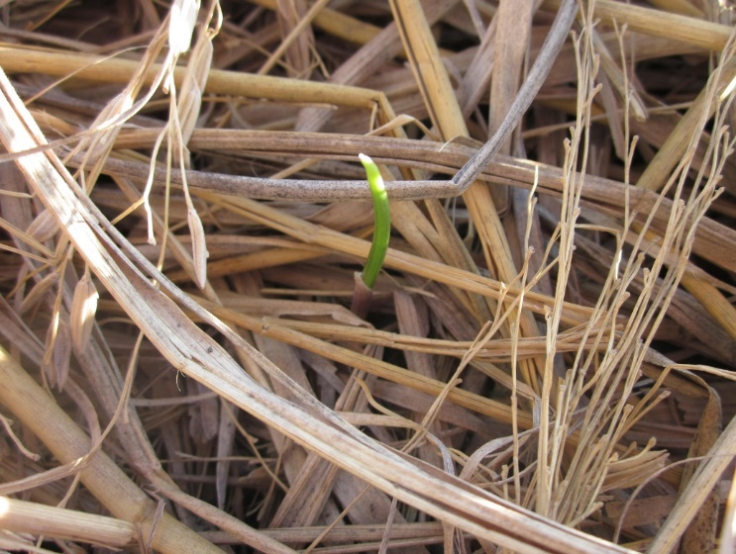
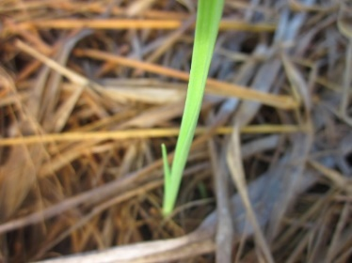
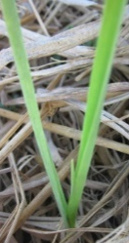
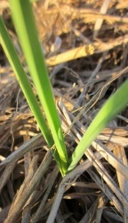
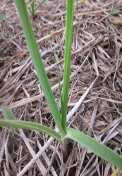
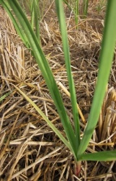
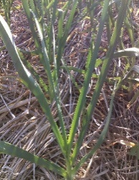
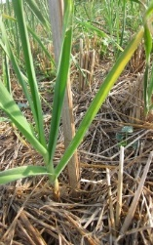
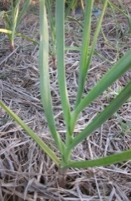
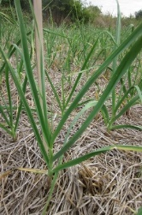
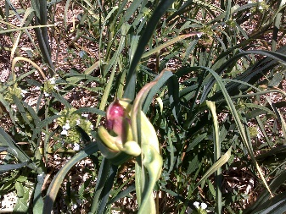
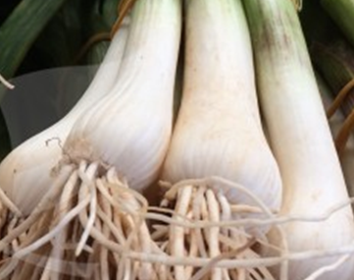
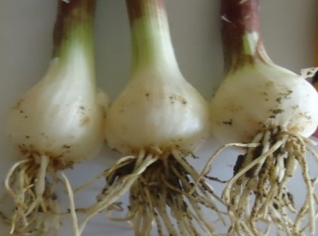
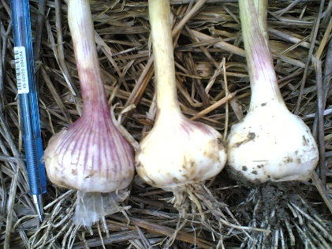
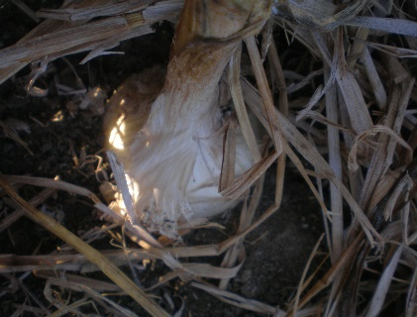
PHENOPHASES OF GARLIC
Planting
Initial stage (Vegetative)
7 to 29 DAP
Bulb Formation
30 to 60 DAP
Bulb Development
60 to 85 DAP
Maturity
85-100 DAP
1st leaf to 5th leaf
6th leaf to 10th leaf
11th leaf to 14th leaf

Slide 2
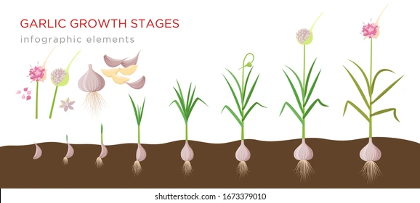

Slide 3
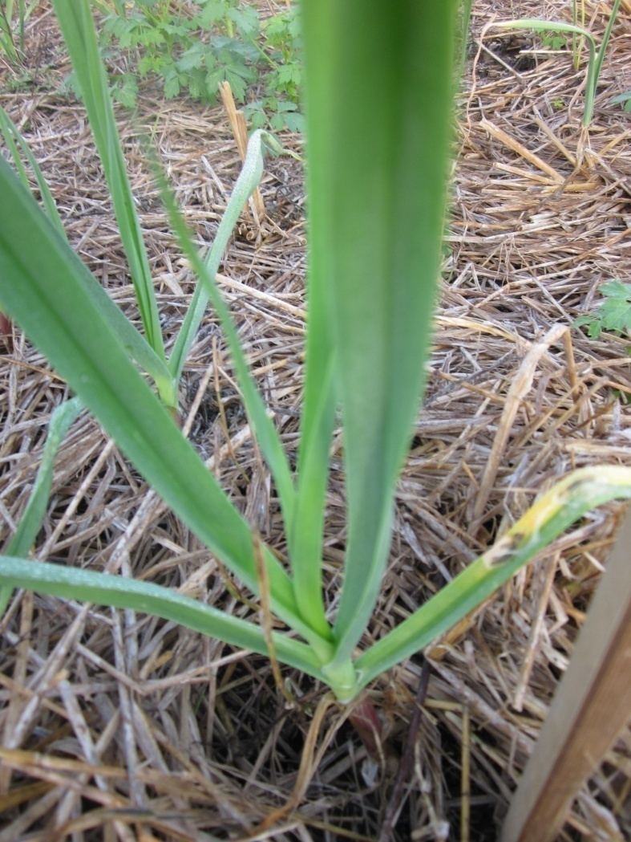
Purple blotch (Alternaria porri L.) has been identified as an important yield limiting disease in garlic.

Slide 4
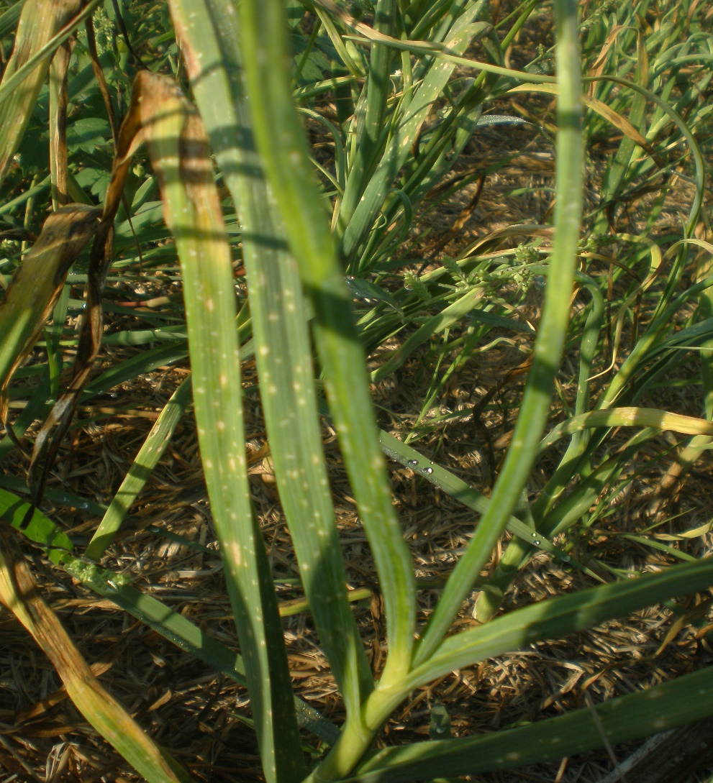
Leaf Spot (Cercospora duddiae)

Slide 5
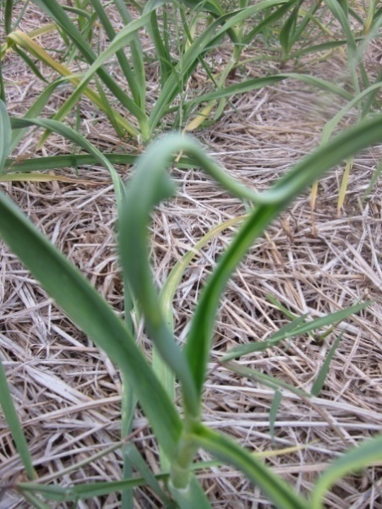
Mite damage (Tangle top)

Slide 6
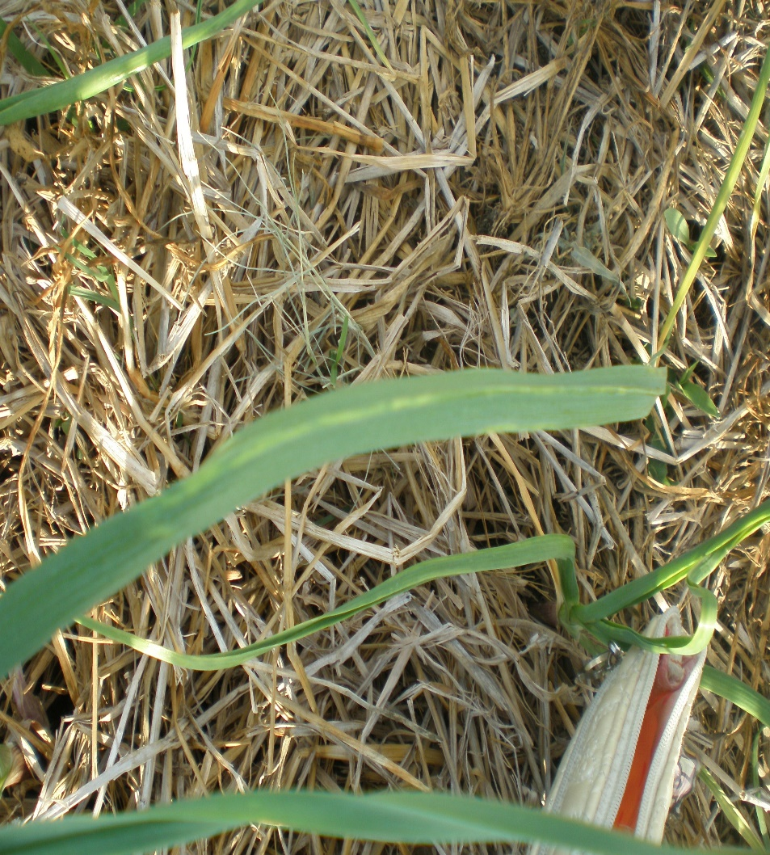
Thrips Damage
Thrip damage appeared as early as the development of the 4th leaf (initial stage) when there was a change (low to high) in air temperature of about 1ºC or more.

Slide 7

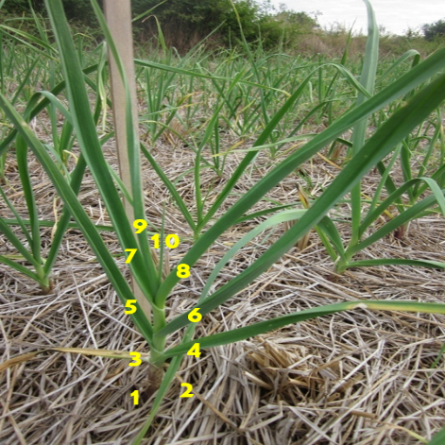
PURPLE BLOTCH
Purple blotch began to have a slight damage to plants during the development of the 9th leaf, 10th leaf, and 8th leaf during October, November, and December plantings, respectively.
Development of 10th leaf

Slide 8
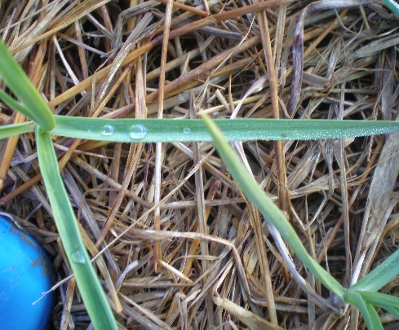
PURPLE BLOTCH
Relative humidity was >85%, and there was an occurrence of rainfall when this disease manifested on leaves.
10
9
7
8
6
5
4
3
2
1

Slide 9

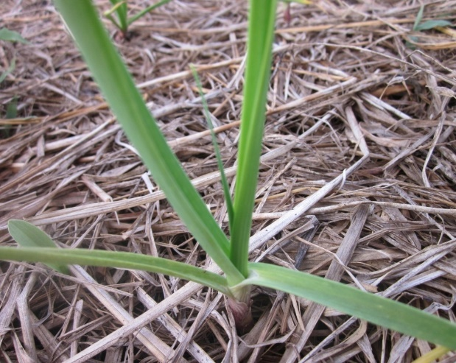
PURPLE BLOTCH
There was no occurrence of the disease during the vegetative stage of the plants even if there was high relative humidity (>90%) and occurrence of rainfall.
4th leaf
5th leaf

Slide 10
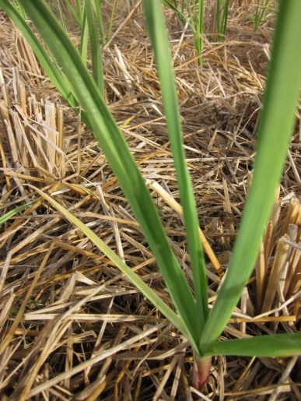

the action threshold of applying pest management strategies to prevent damaging levels of the A. porri is during the bulb formation stage

Slide 11
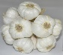
or
40-45 days after planting or during the development of 7th to 8th leaves
when there is an occurrence of rainshowers or if the relative humidity is more than 85%
when there is an abrupt change of relative humidity (from high to low)

